Slide 1
MPAI Progress
Feb 2016

Slide 2
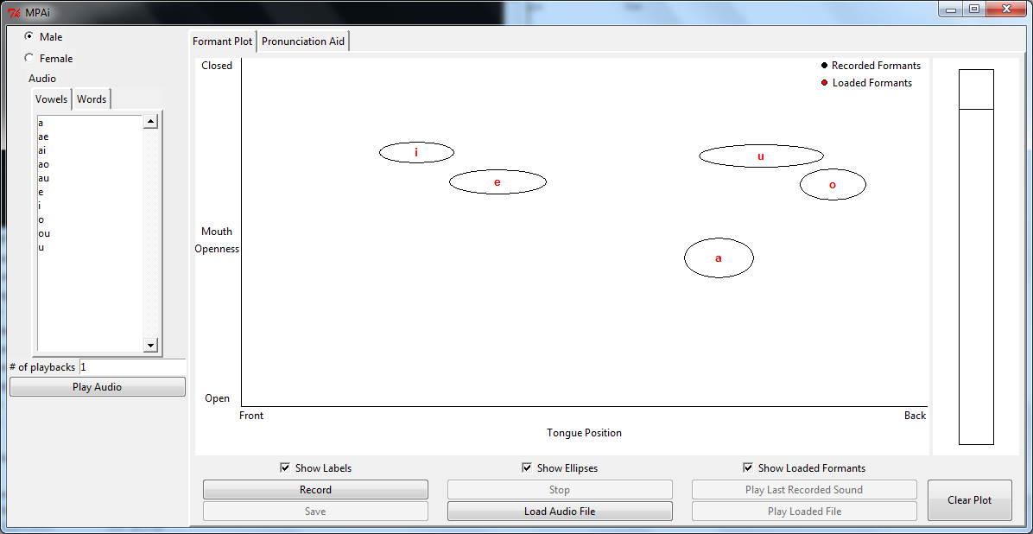
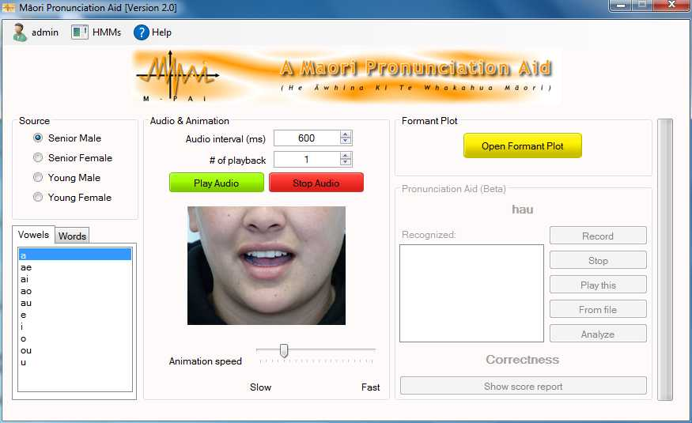
Past Progress of Aid
At Feb 2015
Formant plot
Access to recordings (vowels, words)
Command line SR
At Oct 2015
Formant plot
Pronunciation feedback based on SR

Slide 3
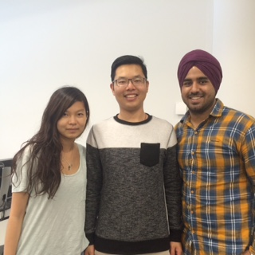
Summer of 2015/2016
The Summer of Progress
Epsom: Peter and Kataraina trialed MPAi with 11 participants
Newmarket: Shawn, Gagan, and Miya worked on a revised version.
https://github.com/YsqEvilmax/MPAid/releases/

Slide 4
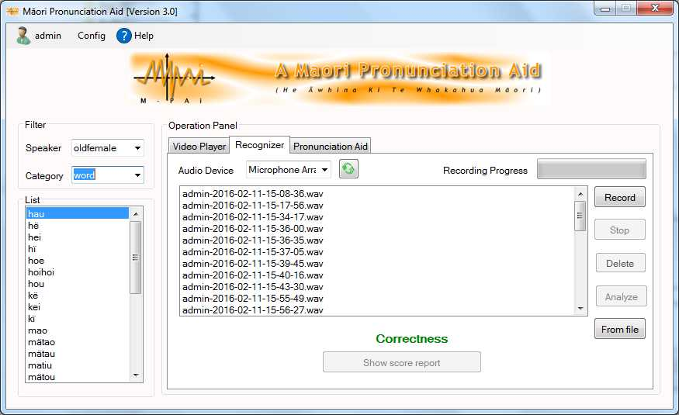
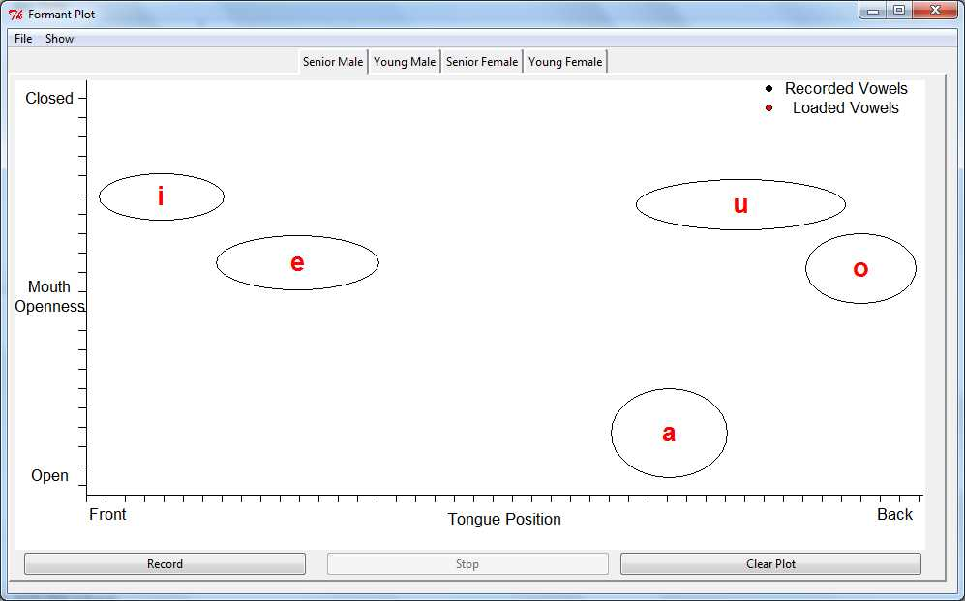
Mpai Feb 2016
Same functionality as before but
New layout
More robust
More stable
More flexible

Slide 5
Newmarket Progress
Gagan worked on the audio and signal processing.
Tested gain setting for microphone, if mic gain too high or low -> inaccuracies
Robustness of Oct 2015 MPAi
Bad sound library used in SR cf. if used at command line
Sensitive to breathing (inhale=“tae”,exhale=“ki”), popping, clipping
Revisted SR process
Investigated what errors occurred. (t→h/p, p→h/t, h→k/p, m→h, oe→oi, oi→oe/ei, iu→au/ao/ë, ei→ae/oi/au, ї→ë, ou→ao, a→ä)
Changed some of the signal processing settings ( from default).
Issues with macrons – meaning SR was not distinguishing between long and short vowel pairs.

Slide 6
Newmarket Progress
Miya worked on making the formant plots more readable, and simplifying the layout.
Shawn worked on the software frame work
Improved the sound library
Automated the SR process (with Gagan)
Re-did the Speech Corpus
Set up the frame work to add more words, and be able to train the SR with a new set of words.
Found a solution for Macrons

Slide 7
Where to next
Second lot of trials
Developing framework for a mobile version of the aid.
Eric Zhai working on this project
Justine Hui to work on a Māori Speech Synthesizer
Need to develop lexicon
Need to select speaker from MAONZE corpus
Only have Justine for 1 month.

